Slide 1
Introduction to Computer Science and Programming
Labo 8 – VS CODE and C++ Exercises
Laboratory 8, December 2, 2025
Filippo Ricca – Muhammad Mohsin
DIBRIS, University of Genova

Slide 2

Today…
Today's lab is dedicated to VS CODE and first examples/exercises in C++
Covered topics in the today evaluated lab:
Quick intro to VS CODE
Professional IDE!
We will use a subset of the features
Setting up VS CODE
C/C++ for VS CODE
C++ exercises
Notes:
Today we will do some simple exercises on using the computer

Slide 3
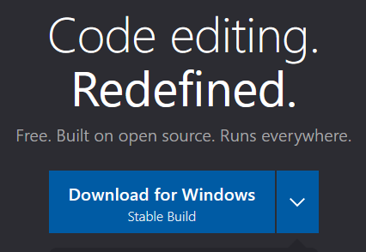
What is VS Code?
Visual Studio Code is a cross-platform and multilanguage source code editor developed by Microsoft
Microsoft, Linux, macOS
C++, Java, Python, Javascript, …
It incorporates the capabilities of Visual Studio while making them lightweight
Launched in 2015, Visual Studio Code marked Microsoft's move toward the open-source community
The source code is available at this link: https://github.com/microsoft/vscode

Slide 4
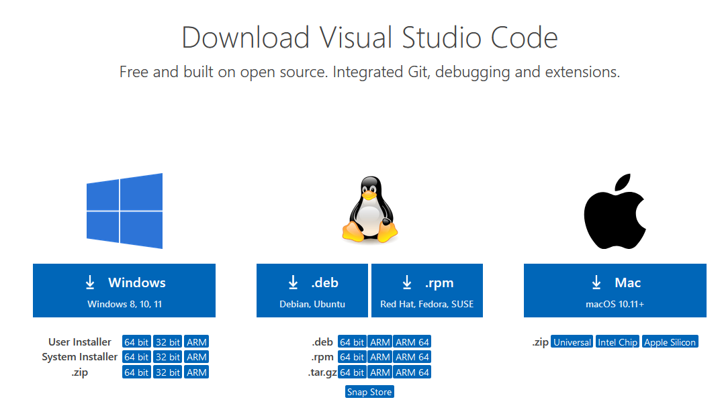

Cross-platform source code editor
Visual Studio Code is natively supported on Linux, Windows, and macOS environments
https://code.visualstudio.com/Download

Slide 5
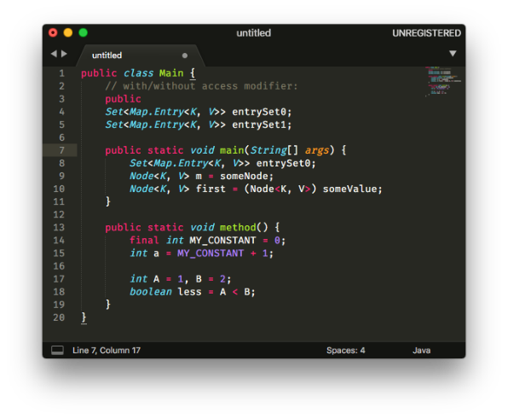
What are its most interesting features?
Syntax Highlight: Syntax coloring
IntelliSense: Autocompletion with documentation
Integrated GIT: Built-in version control software
Integrated Debugging: Error detection and correction with breakpoint definition
Extensions (plug-ins): Ability to easily and quickly add additional features
We will understand these features better in the upcoming lessons

Slide 6
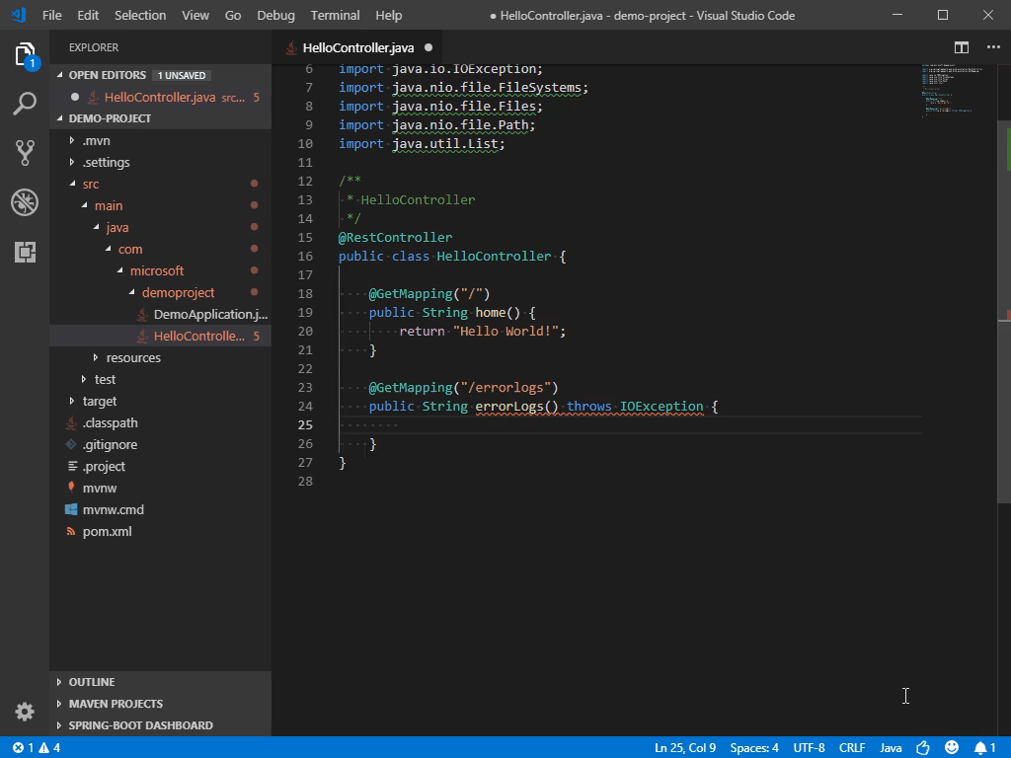
IntelliSense (Code Completion)
It helps speed up the coding phase
Notes:
IntelliSense is a general term for various code editing features including: code completion, parameter info, quick info, and member lists. IntelliSense features are sometimes called by other names such as "code completion", "content assist", and "code hinting.“
Code snippets are templates that make it easier to enter repeating code patterns, such as loops or conditional-statements.

Slide 7
Why was VS Code chosen?
Cross-Platform Compatibility: Works seamlessly on Windows, macOS, and Linux, providing a consistent experience across different systems
IntelliSense and Autocompletion: Offers smart code suggestions, syntax highlighting, and inline documentation, boosting productivity and reducing errors
Integrated Version Control: Built-in Git support allows for easy version control, commit management, and collaboration directly within the editor
Extensive Extension Marketplace: A vast library of extensions and plug-ins enables customization and additional functionality for different languages and tools
Lightweight and Fast: Despite its rich features, VS Code is lightweight and responsive, making it ideal for both large and small projects
It is widely used in practice in companies!

Slide 8
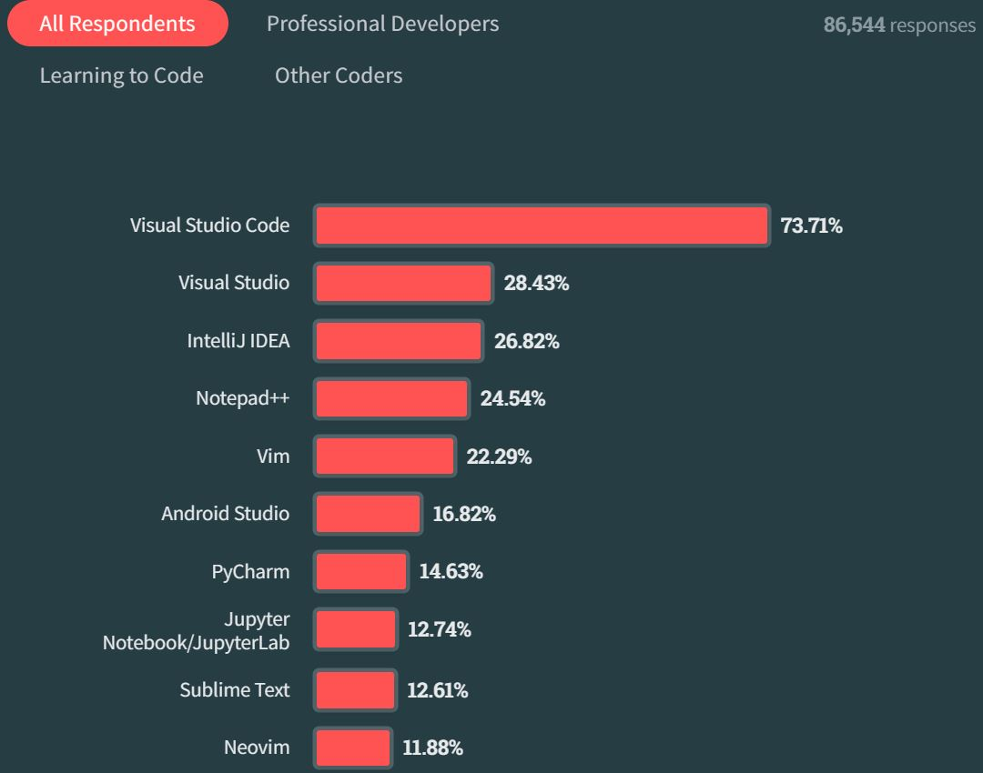
Stack Overflow 2023 Developer Survey
Visual Studio Code remains the preferred IDE across all developers, increasing its use among all developers this year from 75 percent to 81 percent

Slide 9
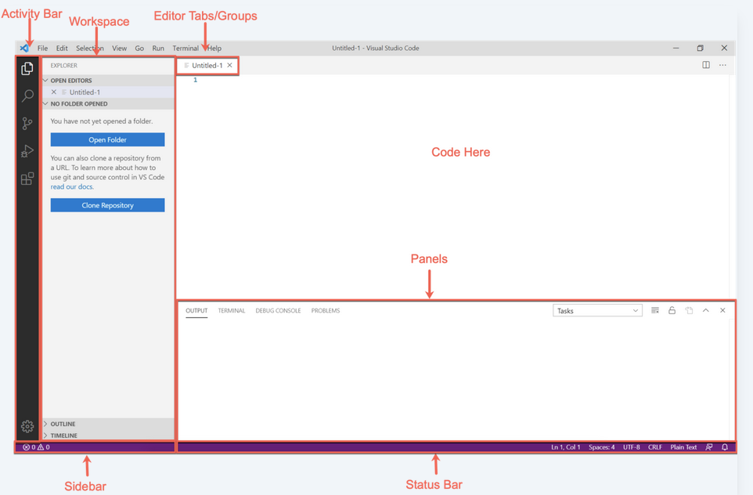
VS CODE GUI
To execute some actions (ex., open a folder, execute a code)
The main navigation area
in VS Code
Code editing area
The content here depends on the activity
For example with Explorer here we have
Folder and Files of the project (and other
views)
An output section consisting of various tabs (Panels) with an integrated Terminal provides a
command-line interface. This allows developers to execute commands directly within
the IDE, making it easier to interact with the system without switching between different
tools or windows
Git repo
Info related to the file opened in the Code editing area

Slide 10
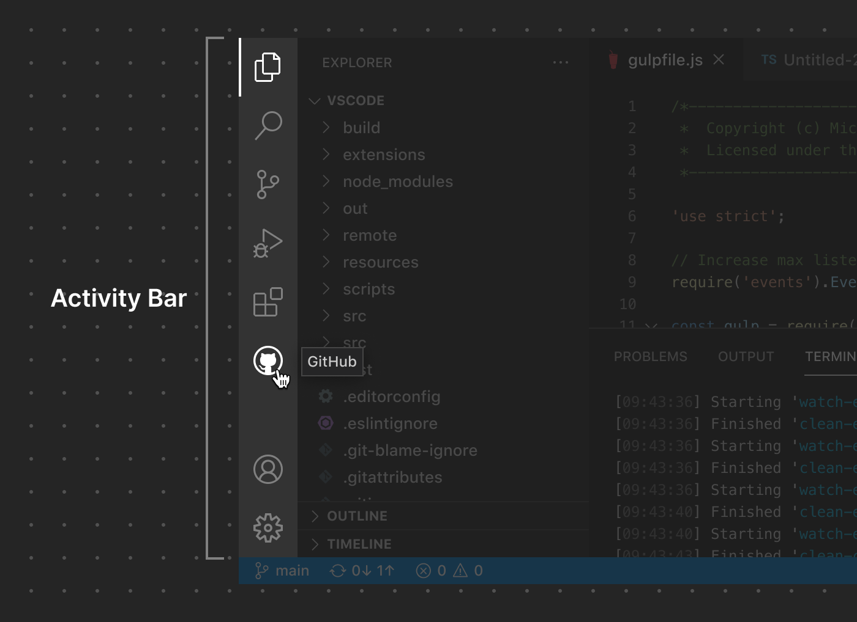

Activity Bar
The Activity Bar is the main navigation area in VS Code, located on the side of the interface. It allows quick access to core features like the Explorer, Search, Source Control, and Extensions
Explorer view
Search
Source Control (Git)
Run and Debug
Extensions
GitHub
Feature added as extension

Slide 11
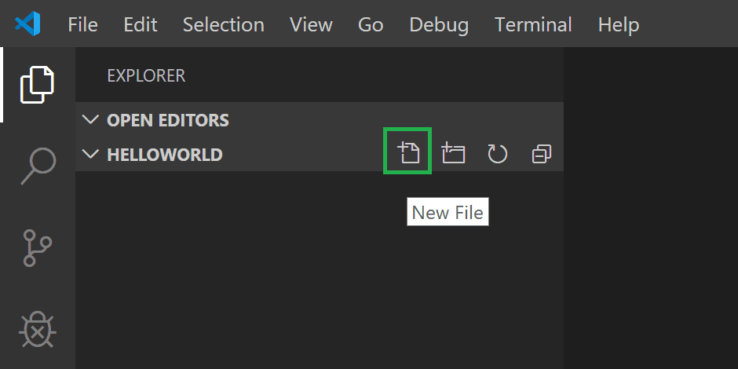
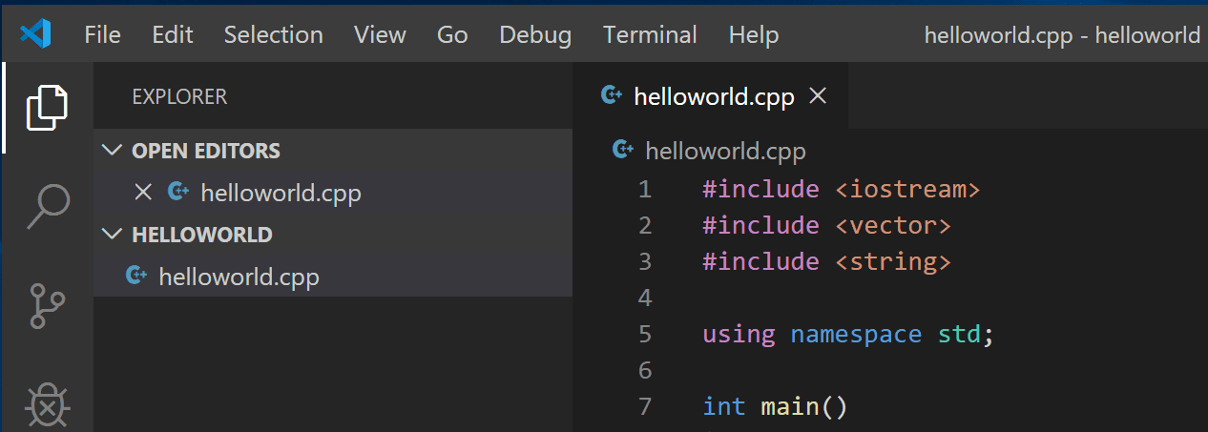
Explorer View
The Explorer view is used to browse, open, and manage the files and folders in your project

Slide 12
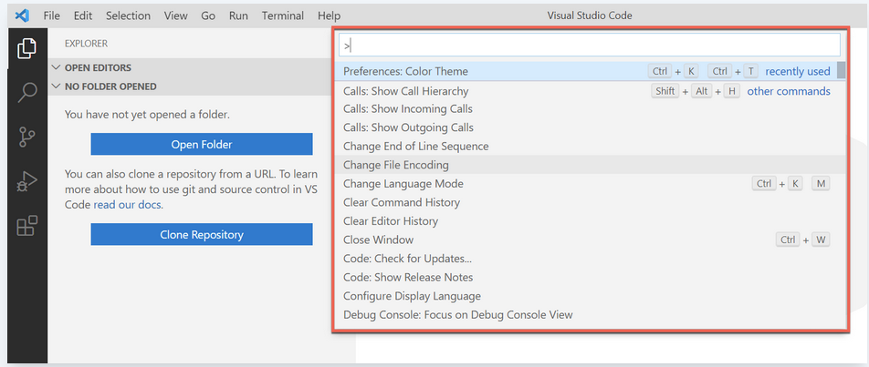
Command Palette
Ctrl+Shift+P
From here, you have access to all functionality within VS Code, including keyboard shortcuts for the most common operations

Slide 13
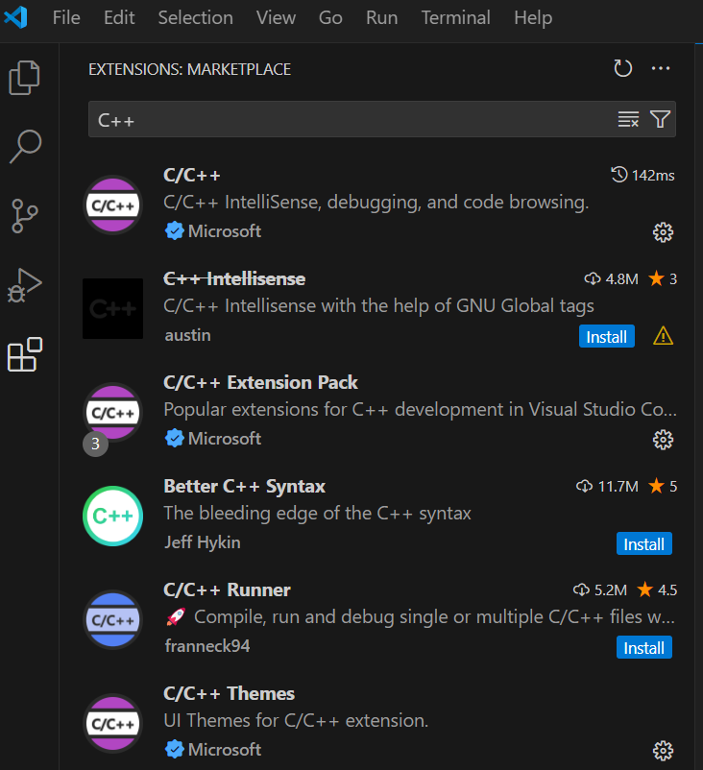
Extensions

Slide 14
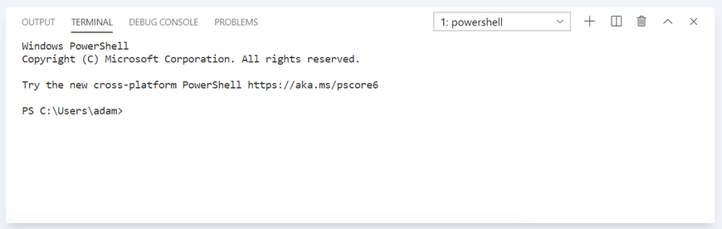
Terminal (CLI)
You can use the integrated terminal just like a typical console by typing commands, obtaining output, and performing various tasks directly within the editor

Slide 15
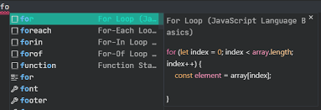
Snippets
Code snippets are templates that make it easier to enter repeating code patterns, such as loops or conditional-statements

Slide 16

Setting up Visual Studio Code
Go to https://code.visualstudio.com/docs/setup/setup-overview
Select the Operating system
Follow the instructions!
Suggestions:
Select all default settings
Choose the look & feel of the GUI
How many of you have not yet installed VS Code?

Slide 17
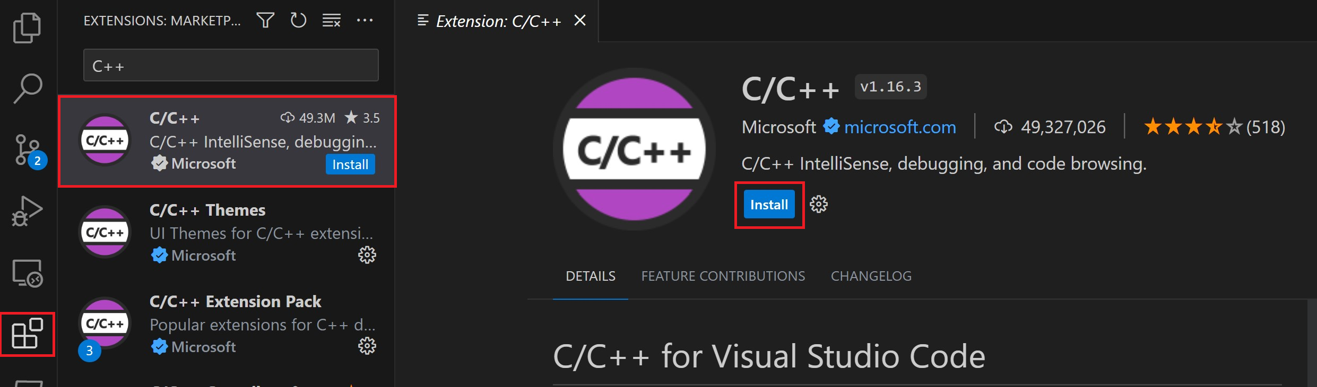
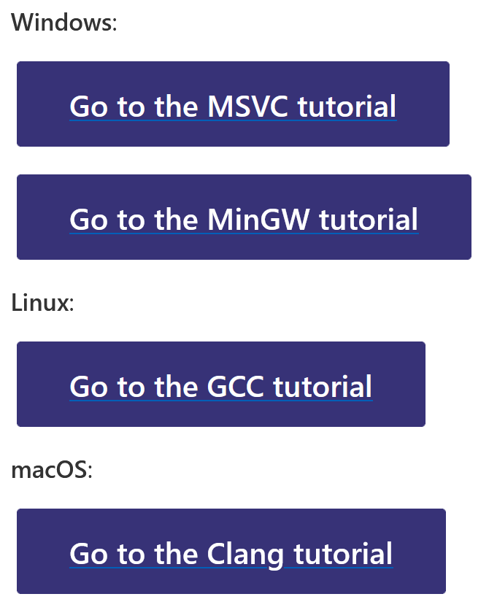
C/C++ for Visual Studio Code
Install the C++ extension in VS CODE
The C/C++ extension doesn't include a C++ compiler or debugger
Install a Compiler
Different options
For Windows: MingGV
How many of you have not yet installed a Compiler?
Problems during installation?
https://code.visualstudio.com/docs/languages/cpp

Slide 18
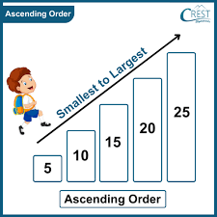
Exercise 1: PRINT THREE NUMBERS IN ASCEDNING ORDER
Write a C++ program that reads five integers and prints them in ascending order
For example:
Input: 10, 20, 15, 5, 25
Output: 5, 10, 15, 20, 25
Notes:
int main() {
int a, b, c;
int minVal, maxVal;
// Reading input values
cout << "Enter three integers: ";
cin >> a >> b >> c;
if ((a < b && a < c)) {
minVal = a; maxVal= c;
} else if ((a < b && a > c)) {
minVal = c; maxVal= b;
} else {
minVal = b; maxVal = a;
}
// Calculate the middle value
int midVal;
if ((a != minVal && a != maxVal)) {
midVal = a;
} else if ((b != minVal && b != maxVal)) {
midVal = b;
} else {
midVal = c;
}
// Print in ascending order
cout << "The numbers in ascending order are: " << minVal << ", " << midVal << ", " << maxVal << endl;
return 0;
}
#include <iostream>
using namespace std;
int main() {
int a, b, c;
// Reading input values
cout << "Enter three integers: ";
cin >> a >> b >> c;
// Calculate min and max using ternary operators
int minVal = (a < b && a < c) ? a : (b < c) ? b : c;
int maxVal = (a > b && a > c) ? a : (b > c) ? b : c;
// Calculate the middle value using ternary operators
int midVal = (a != minVal && a != maxVal) ? a :
(b != minVal && b != maxVal) ? b : c;
// Print in ascending order
cout << "The numbers in ascending order are: " << minVal << ", " << midVal << ", " << maxVal << endl;
return 0;
}

Slide 19
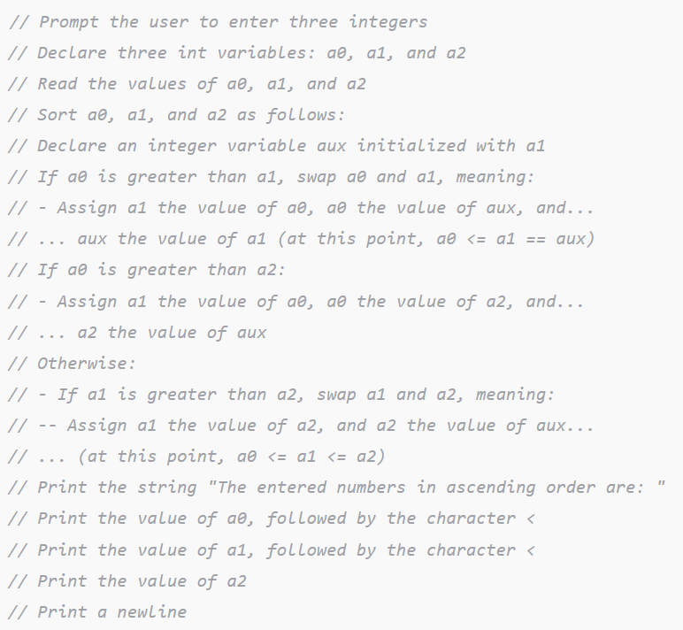
Exercise 1: PRINT THREE NUMBERS IN ASCEDNING ORDER
Following is the proposed algorithm given in pseudocode (which specifies additional details).
For example:
Output: 5, 10, 15, 20, 25
Notes:
#include <iostream>
using namespace std;
int main() {
// Prompt the user to enter three integers
cout << "Enter three integers: ";
// Declare three int variables a0, a1, and a2
int a0, a1, a2;
// Read the values of a0, a1, and a2
cin >> a0 >> a1 >> a2;
// Sort a0, a1, and a2
// Declare an auxiliary int variable aux initialized with a1
int aux = a1;
// If a0 is greater than a1, swap them
if (a0 > a1) {
a1 = a0;
a0 = aux;
aux = a1;
}
// If a0 is greater than a2, perform another swap
if (a0 > a2) {
a1 = a0;
a0 = a2;
a2 = aux;
}
// Otherwise, check if a1 is greater than a2 and swap them
else if (a1 > a2) {
a1 = a2;
a2 = aux;
}
// Print the sorted numbers
cout << "The numbers in ascending order are: ";
cout << a0 << " < " << a1 << " < " << a2 << endl;
return 0;
}

Slide 20
Exercise 2: DISPLAYING TIME
The time(0) function in the ctime header file returns the current time in seconds elapsed since the time 00:00:00 on January 1, 1970 GMT
Write a C++ program that displays the current time in the format hour:minute:second
Notes:
#include <iostream>
#include <ctime>
int main() {
// Get current time in seconds since Jan 1, 1970 (Unix epoch)
time_t now = time(0);
std::cout << now << std::endl;
// Convert seconds since epoch to hours, minutes, seconds
// (GMT/UTC time, since we are not using localtime)
long seconds = now % 86400; // seconds in a day
int hour = seconds / 3600;
int minute = (seconds % 3600) / 60;
int second = seconds % 60;
// Print with manual formatting (no setfill)
if (hour < 10) std::cout << "0";
std::cout << hour << ":";
if (minute < 10) std::cout << "0";
std::cout << minute << ":";
if (second < 10) std::cout << "0";
std::cout << second << std::endl;
return 0;
}

Slide 21
Exercise 3: FARE CALCULATION
Write a C++ program that reads the number of kilometers traveled by a taxi.
Example: Input: 22 Output: Final price based on the rules
in euros.
The fare rules are:
Base fare: 5 €
Each kilometer costs:
2 € if the distance is 10 km or less
1.50 € if the distance is more than 10 km
Notes:
#include <iostream>
using namespace std;
int main() {
double km;
cout << "Enter the number of kilometers: ";
cin >> km;
double fare = 5; // Base fare
if (km <= 10) {
fare += km * 2; // 2 € per km for the first 10 km
} else {
fare += 10 * 2; // Cost for first 10 km
fare += (km - 10) * 1.5; // Cost for additional km
}
cout << "Total fare: " << fare << " €" << endl;
return 0;
}

Slide 22
Exercise 4: AVERAGE GRADE CALCULATION
Write a C++ program that reads three test scores and calculates the average grade.
Grading Scale:
A: 90-100
B: 80-89
C: 70-79
D: 60-69
F: Below 60
Requirements:
Calculate the average as a decimal number
Display both the average and the letter grade
Add a message like "Excellent!" for A, "Good job!" for B, etc.
Notes:
#include <iostream>
using namespace std;
int main() {
double score1, score2, score3;
// Read three test scores
cout << "Enter three test scores: ";
cin >> score1 >> score2 >> score3;
// Calculate average
double average = (score1 + score2 + score3) / 3.0;
// Determine letter grade and message
char grade;
string message;
if (average >= 90 && average <= 100) {
grade = 'A';
message = "Excellent!";
} else if (average >= 80 && average < 90) {
grade = 'B';
message = "Good job!";
} else if (average >= 70 && average < 80) {
grade = 'C';
message = "Well done!";
} else if (average >= 60 && average < 70) {
grade = 'D';
message = "You passed.";
} else {
grade = 'F';
message = "Better luck next time.";
}
// Display results
cout << "Average score: " << average << endl;
cout << "Letter grade: " << grade << endl;
cout << message << endl;
return 0;
}

Slide 23
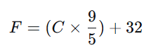
Exercise 5: CELSIUS TO FAHRENHEIT CONVERSION
Write a C++ program that converts a temperature from Celsius to Fahrenheit.
Example:
0°C should give 32°F (freezing point)
100°C should give 212°F (boiling point)
37°C should give 98.6°F (body temperature)
-40°C should give -40°F (interesting coincidence!)
Formula:
Notes:
#include <iostream>
using namespace std;
int main() {
double celsius, fahrenheit;
// Ask the user for input
cout << "Enter temperature in Celsius: ";
cin >> celsius;
// Convert Celsius to Fahrenheit
fahrenheit = (celsius * 9.0 / 5.0) + 32;
// Display the result
cout << celsius << "C is " << fahrenheit << "F" << endl;
return 0;
}

